Slide 1
NAME: KINYUA KEVIN REG NO: SCT212-0658/2021 UNIT: COMPUTER ARCHITECTURE

Slide 2
CHAPTER ONE: FUNDAMENTALS OF COMPUTER DESIGN/QUANTITATIVE ANALYSIS AND DESIGN
1.1 Introduction.
1.2 Classes of computers.
1.3 Defining computer architecture.
1.4 Trends in technology.
1.5 Trends in power and energy in integrated circuits.
1.6 Trends in cost.

Slide 3
INTRODUCTION
Computer technology has made incredible progress in the roughly 65 years since the first general-purpose electronic computer was created.
Today, less than $500 will purchase a mobile computer that has more performance, more main memory and more disk storage than a computer bought in 1985 for $1 million.
Although technological improvements have been fairly steady, progress arising from better computer architectures has been much less consistent.
During the first 25 years of electronic computers, both forces made a major contribution delivering performance improvement of about 25% per year.
The late 1970s saw the emergence of the microprocessor. The ability of the microprocessor to ride the improvements in integrated circuit technology led to a higher rate of performance improvement translating to roughly 35% growth per year.

Slide 4
INTRODUCTION
Two significant changes in the computer marketplace made it easier than ever before to succeed commercially with a new architecture.
First, the virtual elimination of assembly language programming reduced the need for object-code compatibility.
Second, the creation of standardized, vendor-independent operating systems such as UNIX and its clone, Linux, lowered the cost and risk of bringing out a new architecture.
These changes made it possible to develop successfully a new set of architectures with simpler instructions called RISC (Reduced Instruction Set Computer) architectures in the early 1980s. The RISC-based machines focused the attention of designers on two critical performance techniques; the exploitation of instruction level parallelism (initially through pipelining and later through multiple instruction issue) and the use of caches (initially in simple forms and later using more sophisticated organizations and optimizations).

Slide 5
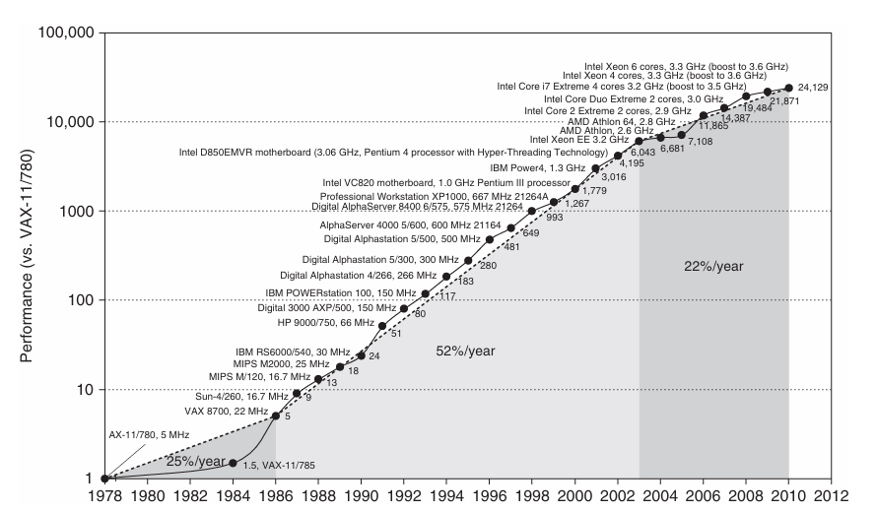
INTRODUCTION
Fig 1: showing the combination of architectural and organizational enhancements led to 17 years of sustained growth in performance at an annual rate of over 50%—a rate that is unprecedented in the computer industry.

Slide 6
INTRODUCTION
The effect of this dramatic growth rate in the 20th century has been fourfold.
First, it has significantly enhanced the capability available to computer users. For many applications, the highest-performance microprocessors of today outperform the supercomputer of less than 10 years ago.
Second, this dramatic improvement in cost-performance leads to new classes of computers. Personal computers and workstations emerged in the 1980s with the availability of the microprocessor. The last decade saw the rise of smart cell phones and tablet computers which many people are using as their primary computing platforms instead of PCs. These mobile client devices are increasingly using the Internet to access warehouses containing tens of thousands of servers, which are being designed as if they were a single gigantic computer.
Third, continuing improvement of semiconductor manufacturing as predicted by Moore’s law has led to the dominance of microprocessor-based computers across the entire range of computer design. Minicomputers, which were traditionally made from off-the-shelf logic or from gate arrays, were replaced by servers made using microprocessors. Even mainframe computers and high performance supercomputers are all collections of microprocessors.

Slide 7
INTRODUCTION
The hardware innovations above led to a renaissance in computer design which brought about the fourth impact which is on software development.
This 25,000-fold performance improvement since 1978 (see Fig 1) allowed programmers today to trade performance for productivity.
In place of performance-oriented languages like C and C++, much more programming today is done in managed programming languages like Java and C#. Moreover, scripting languages like Python and Ruby, which are even more productive, are gaining in popularity along with programming frameworks like Ruby on Rails.
To maintain productivity and try to close the performance gap, interpreters with just-in-time compilers and trace-based compiling are replacing the traditional compiler and linker of the past. Software deployment is changing as well with Software as a Service (SaaS) used over the Internet replacing shrink wrapped software that must be installed and run on a local computer.

Slide 8
CLASSES OF COMPUTERS
Personal Mobile Device (PMD) – This is any personal electronic device that can be used to communicate or to access the internet such as a cellphone or a tablet.
Desktop Computing – This refers to the use of a personal computer in a form intended for regular use at a single location. They utilize peripheral devices for interaction such as a keyboard and mouse for input and display devices like a monitor, projector or television. Desktop computers can have a horizontal or vertical (tower) form factor or be combined with a monitor to create an All-in-One computer. Unlike a laptop which is portable, desktop computers are generally made to stay at one location.
Servers – These are programs or devices that provides functionality for clients which are other programs or devices.
Clusters/Warehouse-scale computers – Clusters are collections of desktop computers or servers connected by local area networks to act as a single larger computer. Warehouse-scale computers form the foundation of internet services that people use for search, social networking, online maps, video sharing, online shopping, email, cloud computing etc.

Slide 9
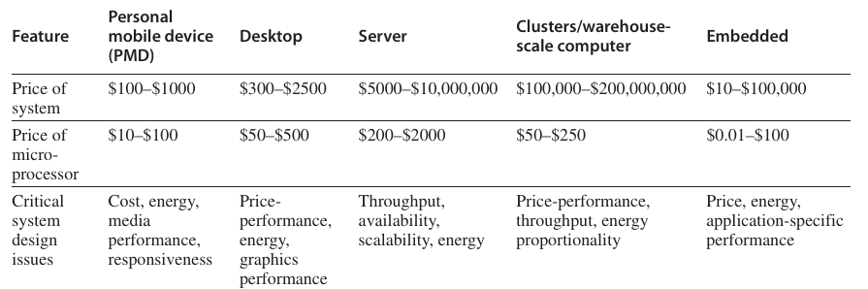
CLASSES OF COMPUTERS
Embedded computers – This is a combination of a computer processor, computer memory and input/output peripheral devices that has a dedicated function within a larger mechanical or electronic system.
The figure below (Fig 2) shows a summary of the five mainstream computing classes and their system characteristics.

Slide 10
CLASSES OF COMPUTERS
There are basically two kinds of parallelism in applications:
Data-Level Parallelism (DLP) – Arises because there are many data items that can be operated on at the same time.
Task-Level Parallelism (TLP) – Arises because tasks of work are created that can operate independently and largely in parallel.
Computer hardware in turn can exploit these two kinds of application parallelism in four major ways:
Instruction-Level Parallelism - Exploits data-level parallelism at modest levels with compiler help using ideas like pipelining and at medium levels using ideas like speculative execution.
Vector Architectures and Graphic Processor Units (GPUs) - Exploit data-level parallelism by applying a single instruction to a collection of data in parallel.
Thread-Level Parallelism - Exploits either data-level parallelism or task-level parallelism in a tightly coupled hardware model that allows for interaction among parallel threads.
Request-Level Parallelism - Exploits parallelism among largely decoupled tasks specified by the programmer or the operating system.

Slide 11
CLASSES OF COMPUTERS
Michael Flynn looked at the parallelism in the instruction and data streams called for by the instructions at the most constrained component of the multiprocessor and placed all computers into one of four categories:
Single instruction stream, single data stream (SISD) - This category is the uniprocessor. The programmer thinks of it as the standard sequential computer, but it can exploit instruction-level parallelism.
Single instruction stream, multiple data streams (SIMD) - The same instruction is executed by multiple processors using different data streams. SIMD computers exploit data-level parallelism by applying the same operations to multiple items of data in parallel. Each processor has its own data memory (hence the MD of SIMD), but there is a single instruction memory and control processor, which fetches and dispatches instructions.
Multiple instruction streams, single data stream (MISD) - No commercial multiprocessor of this type has been built to date but it rounds out this simple classification.
Multiple instruction streams, multiple data streams (MIMD) - Each processor fetches its own instructions and operates on its own data and it targets task-level parallelism.

Slide 12
DEFINING COMPUTER ARCHITECTURE
INSTRUCTION SET ARCHITECTURE (ISA)
Class of ISA - Nearly all ISAs today are classified as general-purpose register architectures where the operands are either registers or memory locations.
Memory addressing - Virtually all desktop and server computers including the 80x86, ARM (Advanced RISC Machines) and MIPS (Million Instructions Per Second) use byte addressing to access memory operands.
Addressing modes - In addition to specifying registers and constant operands, addressing modes specify the address of a memory object. MIPS addressing modes are Register, Immediate (for constants) and Displacement, where a constant offset is added to a register to form the memory address.

Slide 13
DEFINING COMPUTER ARCHITECTURE
Types and sizes of operands - Like most ISAs, 80x86, ARM and MIPS support operand sizes of 8-bit (ASCII character), 16-bit (Unicode character or half word), 32-bit (integer or word), 64-bit (double word or long integer) and IEEE 754 floating point in 32-bit (single precision) and 64-bit (double precision). The 80x86 also supports 80-bit floating point (extended double precision).
Operations - The general categories of operations are data transfer, arithmetic logical, control and floating point.
Control flow instructions - Virtually all ISAs support conditional branches, unconditional jumps, procedure calls and returns.
Encoding an ISA - There are two basic choices on encoding: fixed length and variable length.

Slide 14
DEFINING COMPUTER ARCHITECTURE
Genuine Computer Architecture: Designing the Organization and Hardware to Meet Goals and Functional Requirements
Organization - Includes the high-level aspects of a computer’s design such as the memory system, the memory interconnect and the design of the internal processor or CPU (central processing unit where arithmetic, logic, branching and data transfer are implemented).
Hardware - Refers to the specifics of a computer including the detailed logic design and the packaging technology of the computer.

Slide 15
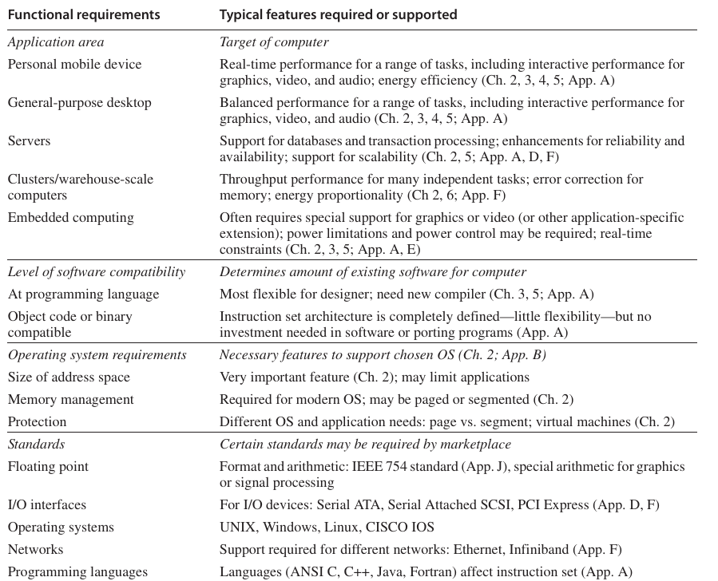
DEFINING COMPUTER ARCHITECTURE
Fig 3: showing summary of some of the most important functional requirements an architect faces.

Slide 16
TRENDS IN TECHNOLOGY
Integrated circuit logic technology - Transistor density increases by about 35% per year, quadrupling somewhat over four years. Increases in die size are less predictable and slower, ranging from 10% to 20% per year. The combined effect is a growth rate in transistor count on a chip of about 40% to 55% per year or doubling every 18 to 24 months.
Semiconductor DRAM (dynamic random-access memory) - Now that most DRAM chips are primarily shipped in DIMM modules, it is harder to track chip capacity as DRAM manufacturers typically offer several capacity products at the same time to match DIMM capacity. Capacity per DRAM chip has increased by about 25% to 40% per year recently, doubling roughly every two to three years.
Semiconductor Flash (electrically erasable programmable read-only memory) - This nonvolatile semiconductor memory is the standard storage device in PMDs and its rapidly increasing popularity has fueled its rapid growth rate in capacity. Capacity per Flash chip has increased by about 50% to 60% per year recently, doubling roughly every two years. In 2011, Flash memory is 15 to 20 times cheaper per bit than DRAM.
Magnetic disk technology - Prior to 1990, density increased by about 30% per year, doubling in three years. It rose to 60% per year thereafter and increased to 100% per year in 1996. Since 2004, it has dropped back to about 40% per year or doubled every three years. Disks are 15 to 25 times cheaper per bit than Flash. Given the slowed growth rate of DRAM, disks are now 300 to 500 times cheaper per bit than DRAM.
Network technology - Network performance depends both on the performance of switches and on the performance of the transmission system

Slide 17
TRENDS IN POWER AND ENERGY IN INTEGRATED CIRCUITS
First, what is the maximum power a processor ever requires? Meeting this demand can be important to ensuring correct operation.
Second, what is the sustained power consumption? This metric is widely called the thermal design power (TDP) since it determines the cooling requirement.
The third factor that designers and users need to consider is energy and energy efficiency. Recall that power is simply energy per unit time: 1 watt = 1 joule per second. Which metric is the right one for comparing processors: energy or power? In general, energy is always a better metric because it is tied to a specific task and the time required for that task. In particular, the energy to exe cute a workload is equal to the average power times the execution time for the workload. Thus, if we want to know which of two processors is more efficient for a given task, we should compare energy consumption (not power) for executing the task.

Slide 18
TRENDS IN POWER AND ENERGY IN INTEGRATED CIRCUITS
For CMOS chips, the traditional primary energy consumption has been in switching transistors, also called dynamic energy.
The energy required per transistor is proportional to the product of the capacitive load driven by the transistor and the square of the voltage: Energydynamic = Capacitive load * Voltage^2 This equation is the energy of pulse of the logic transition of 0→1→0 or 1→0→1.
The energy of a single transition (0→1 or 1→0) is then: Energydynamic = 1/2 * Capacitive load * Voltage^2
The power required per transistor is just the product of the energy of a transition multiplied by the frequency of transitions: Powerdynamic = 1/2 * Capacitive load * Voltage^2 * Frequency switched
For a fixed task, slowing clock rate reduces power but not energy. Clearly, dynamic power and energy are greatly reduced by lowering the voltage so voltages have dropped from 5V to just under 1V in 20 years. The capacitive load is a function of the number of transistors connected to an output and the technology, which determines the capacitance of the wires and the transistors.

Slide 19
TRENDS IN POWER AND ENERGY IN INTEGRATED CIRCUITS
Example: Some microprocessors today are designed to have adjustable voltage, so a 15% reduction in voltage may result in a 15% reduction in frequency. What would be the impact on dynamic energy and on dynamic power?
Answer: Since the capacitance is unchanged, the answer for energy is the ratio of the voltages since the capacitance is unchanged: Energynew / Energyold = (Voltage * 0.85)^2 / Voltage^2 = 0.85^2 = 0.72 thereby reducing energy to about 72% of the original.
For power, we add the ratio of the frequencies Powernew / Powerold = 0.72 * (Frequency switched * 0.85) / Frequency switched = 0.61 shrinking power to about 61% of the original.

Slide 20
TRENDS IN POWER AND ENERGY IN INTEGRATED CIRCUITS
Distributing the power, removing the heat and preventing hot spots have become increasingly difficult challenges. Power is now the major constraint to using transistors; in the past, it was raw silicon area. Hence, modern microprocessors offer many techniques to try to improve energy efficiency despite flat clock rates and constant supply voltages:
Do nothing well - Most microprocessors today turn off the clock of inactive modules to save energy and dynamic power.
Dynamic Voltage-Frequency Scaling (DVFS) - The second technique comes directly from the formulas above. Personal mobile devices, laptops and even servers have periods of low activity where there is no need to operate at the highest clock frequency and voltages.
Design for typical case - Given that PMDs and laptops are often idle, memory and storage offer low power modes to save energy. For example, DRAMs have a series of increasingly lower power modes to extend battery life in PMDs and laptops, and there have been proposals for disks that have a mode that spins at lower rates when idle to save power.
Overclocking - Intel started offering Turbo mode in 2008, where the chip decides that it is safe to run at a higher clock rate for a short time possibly on just a few cores until temperature starts to rise. For example, the 3.3 GHz Core i7 can run in short bursts for 3.6 GHz.

Slide 21
TRENDS IN COST
Cost of integrated circuit = (Cost of die + Cost of testing die + Cost of packaging and final test) / Final test yield
Cost of die = Cost of wafer / (Dies per wafer * Die yield)
Dies per wafer =[π * (Wafer diameter / 2)^2] / Die area - (π * Wafer diameter) / square root (2 * Die area)

Slide 22
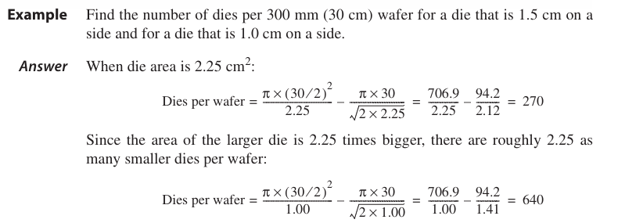
TRENDS IN COST

Slide 23
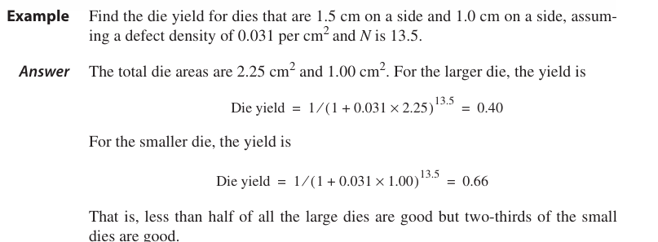
TRENDS IN COST

